Slide 1
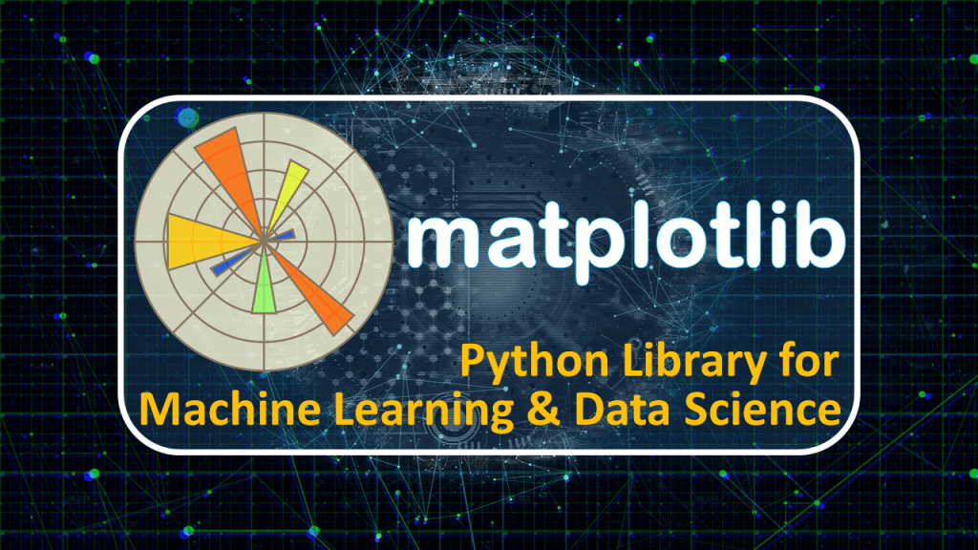

Slide 2
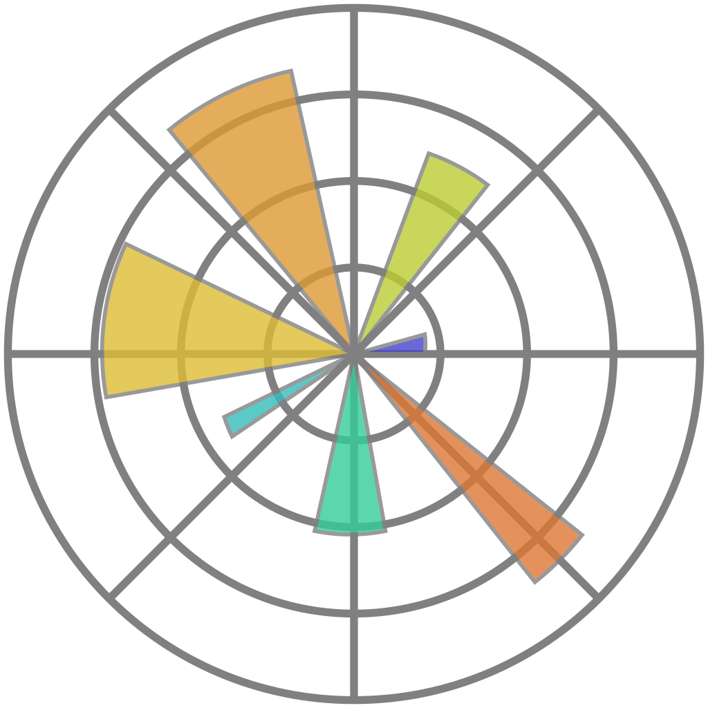
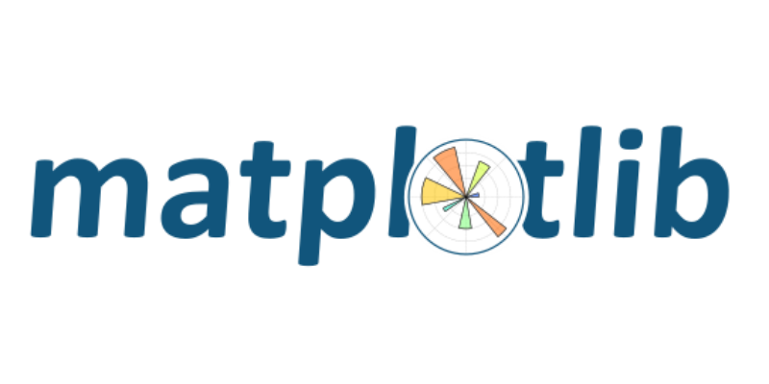
What is Matplotlib?
Matplotlib is a low level graph plotting library in python that serves as a visualization utility.
Matplotlib was created by John D. Hunter.
Matplotlib is open source and we can use it freely.
Matplotlib is mostly written in python, a few segments are written in C, Objective-C and Javascript for Platform compatibility.

Slide 3
Installation of Matplotlib
If you have Python and PIP already installed on a system, then installation of Matplotlib is very easy.
Install it using this command:
C:\Users\Your Name>pip install matplotlib
If this command fails, then use a python distribution that already has Matplotlib installed, like Anaconda, Spyder etc.
Import Matplotlib
Once Matplotlib is installed, import it in your applications by adding the import module statement:
import matplotlib
Now Matplotlib is imported and ready to use:
Checking Matplotlib Version
The version string is stored under __version__ attribute.
import matplotlib
print(matplotlib.__version__)

Slide 4
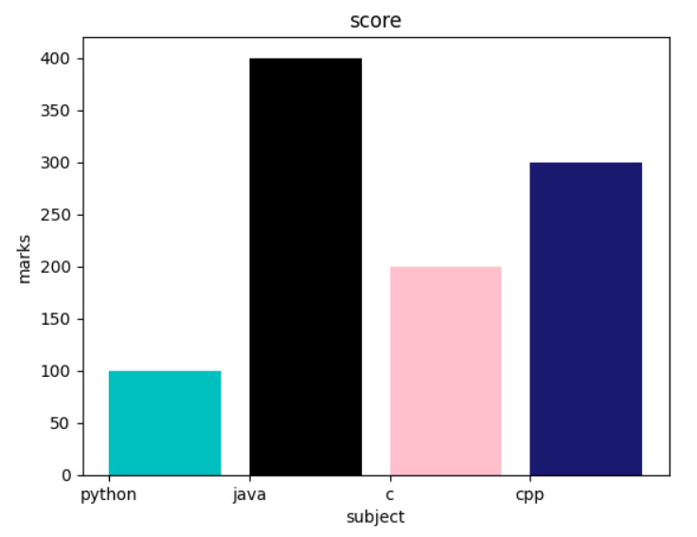
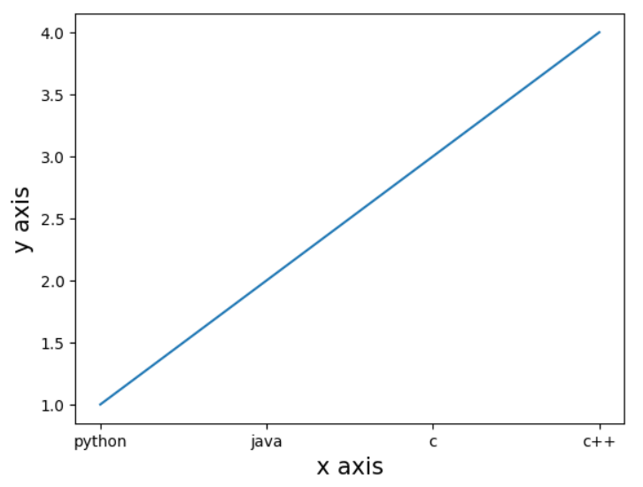
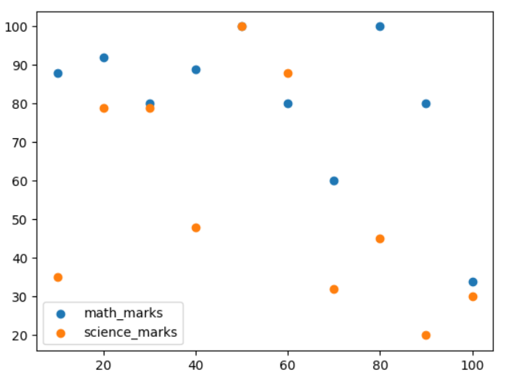
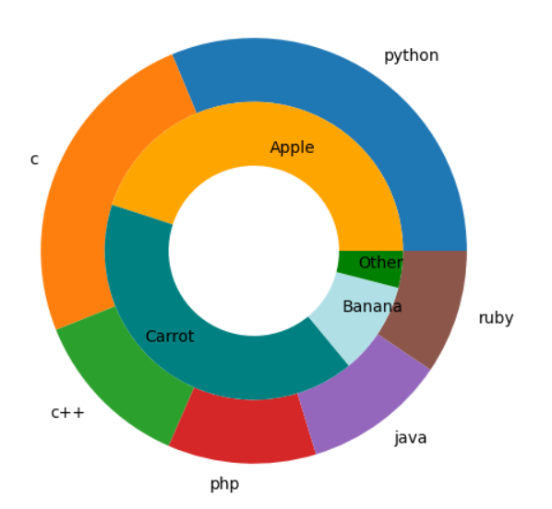
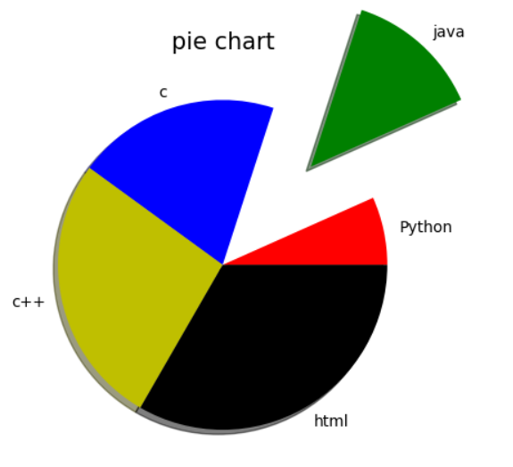
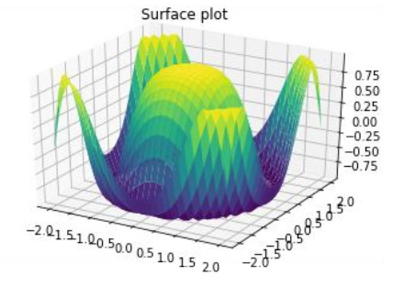
Topics
1. Bar Plot
2. Scatter Plot
3. Pie Chart
4. Line Plot
5. Donut Chart
5. 3D Plot

